Slide 1
MODULE- 2
(2nd Series Exam portions)

Slide 2
Information architecture (IA) & Application structure
Information architecture (IA) is the art of organizing an information space. It encompasses many things: presenting, searching, browsing, labeling, categorizing, sorting, manipulating, and strategically hiding information.
Especially if you’re working with a new product, this is where you should start.
Application structure refers to the overall architecture of an application, including how different components interact and how information flows within the system. It encompasses both the technical and user-facing aspects of an application.

Slide 3
Introduction to information architecture and application structure
At the highest level of application design, it's essential to consider the various functions of sites or app serves, such as providing software services, sharing information, selling products, branding, and facilitating social communication. The home page should effectively guide users to their desired areas through clear text and imagery.
Key decisions at this level include
selecting an interaction model
whether to use a desktop metaphor
a traditional website layout, or a more interactive approach.
This model ensures consistency and defines how users navigate through different functionalities.

Slide 4
When focusing on smaller units within the application, such as pages dedicated to specific functions, each page typically serves one of four primary purposes:
Displaying a single item (e.g., a map or video).
Presenting a list or collection of items.
Offering tools for creation (e.g., a document editor).
Facilitating a specific task (e.g., a registration form).
Most apps combine these functions, and each part should be designed to fit its main purpose. This follows Theresa Neil's framework, which organizes app structures based on user goals: information, process, and creation.

Slide 5
Displaying a single item
The primary focus of your page's design is to showcase or play a single piece of content without distractions
Key Considerations:
Your main task is to manage user interaction with this singular piece of content.
The Information Architecture (IA) is likely straightforward, with minor tools surrounding the content (e.g., scrollers, sliders, sign-in boxes, global navigation, headers, and footers).

Slide 6
Displaying a single item
Possible Design Shapes:
Long, Vertically Scrolled Page: Ideal for articles, books, and other long-form content.
Zoomable Interface: Suitable for large, detailed artifacts like maps or images (e.g., Google Maps).
Media Player Idiom: For video and audio content.
Design Patterns and Techniques to support design:
Alternative Views: Offer multiple ways to present the content.
Many Workspaces: Allow users to view multiple states or documents simultaneously.
Deep-linked State: Enable users to save specific locations within the content for easy return or sharing via URL.
Sharing Widget: Incorporate social sharing features.
Mobile Patterns: Consider mobile-friendly designs if targeting mobile device users.

Slide 7
Presenting a list or collection of items
Common List Formats: Digital artifacts often utilize various list formats, including text lists, menus, image grids, search results, email threads, tables, and trees.
Lists present rich challenges in information architecture.
Information Architecture Challenges:
Length of the list
Flat vs. hierarchical structure
Ordering and dynamic reordering options
Filtering and searching capabilities
Associated information or operations for each item

Slide 8
Presenting a list or collection of items
Design Patterns:
Feature, Search, and Browse: Common in e-commerce and content sites, allowing users to search or browse items, with a featured item on the front page.
News Stream: Used by blogs and social media, displaying the most recent updates at the top.
Picture Manager: A specialized interface for managing photos, supporting both hierarchical and flat lists, with tools for arrangement and direct operations on images.
Integration of Techniques: Once a primary design pattern is chosen, consider additional techniques (e.g., Thumbnail Grid, Pagination) to enhance list presentation within the selected framework

Slide 9
Offering tools for creation
Key Examples: Microsoft Office Suite (Word, Excel, PowerPoint), Adobe Creative Suite (Photoshop, Illustrator, InDesign, Dreamweaver), and various code editors/IDEs.
At the level of application structure or IA, the following patterns are often found to design different aspects of these tools
Canvas Plus Palette: A recognizable pattern for visual editors that sets strong user expectations.
Many Workspaces: Allows users to manage multiple documents in parallel through separate windows.
Alternative Views: Enables users to view a single document through different perspectives.
Blank Slate Invitation: Encourages users to start new projects with a clean slate, enhancing creativity and usability.

Slide 10
Facilitating a specific task
User Interface Design for Task Completion
Signing in, registering, posting, printing, uploading, purchasing, changing a setting—all such tasks fall into this category.
The interface should prioritize getting tasks done
Role of Forms: Forms are essential for facilitating user tasks.
Task Complexity:
For simple tasks, a contained area (like a sign-in box) suffices.
For more complex tasks (long, branched, or with many options), it's important to structure the task effectively.
Breaking Down Tasks:
Consider using a Wizard for guiding users through multi-step tasks.
Settings Editor:
This interface allows users to change settings/preferences without a step-by-step approach. Users should have open access to various options and be able to navigate freely.

Slide 11
The Patterns
Interface patterns that define interactions for significant parts of applications or websites.
Patterns like Picture Manager, Canvas Plus Palette, and Feature, Search, and Browse are "guilds" of smaller patterns, working together to provide comprehensive functionality and user experience across large sections or entire sites.

Slide 12
The Patterns
1. Feature, Search, and Browse
2. News Stream
3. Picture Manager
4. Dashboard
5. Canvas Plus Palette
6. Wizard
7. Settings Editor
The last three patterns are more “meta,” in the sense that they can apply to the other patterns in the preceding list
8. Alternative Views
9. Many Workspaces
10. Multi-Level Help

Slide 13
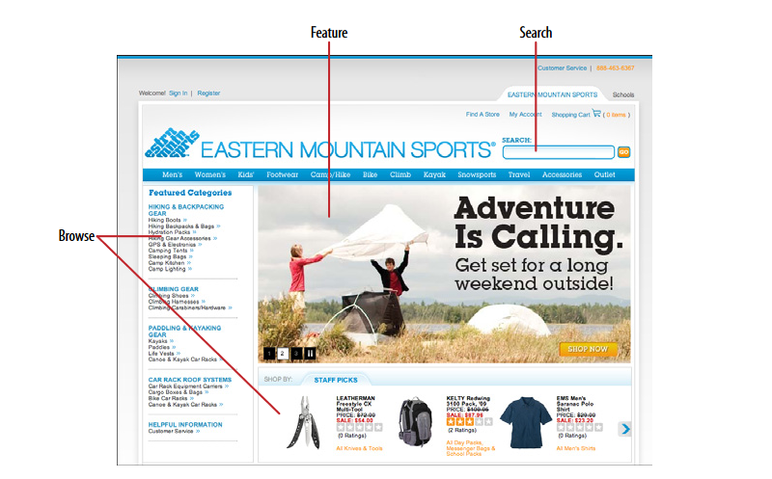
1. Feature, Search, and Browse
Put three elements on the main page of the site or app: a featured article or product, a search box, and a list of items or categories that can be browsed
This approach helps users quickly find engaging content and encourages them to explore more of what your site has to offer.

Slide 14
1. Feature, Search, and Browse - WHY
Successful sites often use three key elements together: search ,browsing options, and featured items.
Search lets users find exactly what they want.
while browsing helps them discover new things.
Featured items grab attention with appealing images and headlines, giving users something interesting to engage with right away.
This approach can make users more interested in your site and keep them exploring.
A user who lands on a page now has something to read or experiment with, without doing any additional work at all and he may find it more interesting than whatever he originally came for.

Slide 15
1. Feature, Search, and Browse- HOW
Place the search box in a prominent spot, like the top corner or across the top of the page. Use whitespace and a different background color to make it stand out and avoid confusion with other text fields.
Set aside Center Stage for the featured article, product, or video. Very near it, and still above the fold, place an area for browsing the rest of the site’s content.
Use lists, menus, or expandable categories to help users explore more easily.
If the category labels open in place to show subcategories, the list behaves like a tree. Some sites, such as Amazon, turn the category labels into menus: when the pointer rolls over the label, a menu of subcategories appears.

Slide 16
1. Feature, Search, and Browse- HOW
Choose your featured items carefully.
Features are a good way to sell items, advertise specials, and call attention to breaking news.
However, they also define what your site is about.
They should reflect your site's values and interests—whether that's promoting products, specials, or charitable efforts.
Understand what your users care about and what will keep them engaged with your site.

Slide 17
2. News Stream- WHAT & WHEN
Display , time-sensitive items in a reverse chronological order, with the latest at the top.
Update the list dynamically and combine items from various sources into a single stream.
Your site or app uses communication channels like blogs, email, social media, or news updates to deliver timely content.

Slide 18
2. News Stream- WHY
News streams are easy to follow because the latest items always appear at the top automatically.
They can check in often and be assured of seeing what they need to see
People visit various sites and apps daily to stay updated on friends, conversations, or topics of interest. Combining multiple news sources into one place makes it easier to keep track of everything. This aligns with the Microbreaks pattern, allowing users to get a lot of information quickly and effortlessly.
For publishers, including a News Box or similar feature on your main page helps visitors see the latest updates and important content, such as new products, blog posts, videos, news, and other initiatives. This is especially useful for large organizations with many ongoing activities.

Slide 19
2. News Stream- HOW
To help users keep up with multiple news sources easily, follow these guidelines:
Display Items: List news items in reverse chronological order, with the newest at the top. If possible, automatically update the list with new items and provide an option to manually refresh.
Organize Streams: For busy feeds, break content into sub streams by topic, sender, or other factors. Allow users to choose which sub streams they want to view.
Information to Include:
What: Show the full micro-update or, for longer content, include a title, brief teaser, and thumbnail image.
Who: Display the name of the author or source, balancing personal names with institutional names.
When: Provide a date or timestamp, and consider using relative times like “Yesterday” or “11 minutes ago.”
Where: Link to the source of the item, or show geolocation data if applicable.

Slide 20
2. News Stream
For handling content in a News Stream:
Expand Content: If an item is too long to display fully, include a “More” link or button to view the entire content. Consider using Two-Panel Selector, One-Window Drilldown, or List Inlay methods to show additional details.
Encourage Interaction: Allow users to quickly respond to items with actions like stars, thumbs-up, likes, or favorites. Also, provide options for longer replies and place these controls next to each item to promote engagement.
Enable Sharing: Facilitate easy sharing of items via email or social media.
Mobile Design: On mobile devices, use a full-screen list, often a Thumbnail-and-Text List, where users can tap or click to view items in detail. Infinite List patterns, which load more content as users scroll, are common in mobile and full-screen designs.
Activity Streams: Note that activity streams focus on time-ordered actions performed by entities (individuals, systems, or organizations), while News Streams aggregate diverse sources of interest to users.

Slide 21
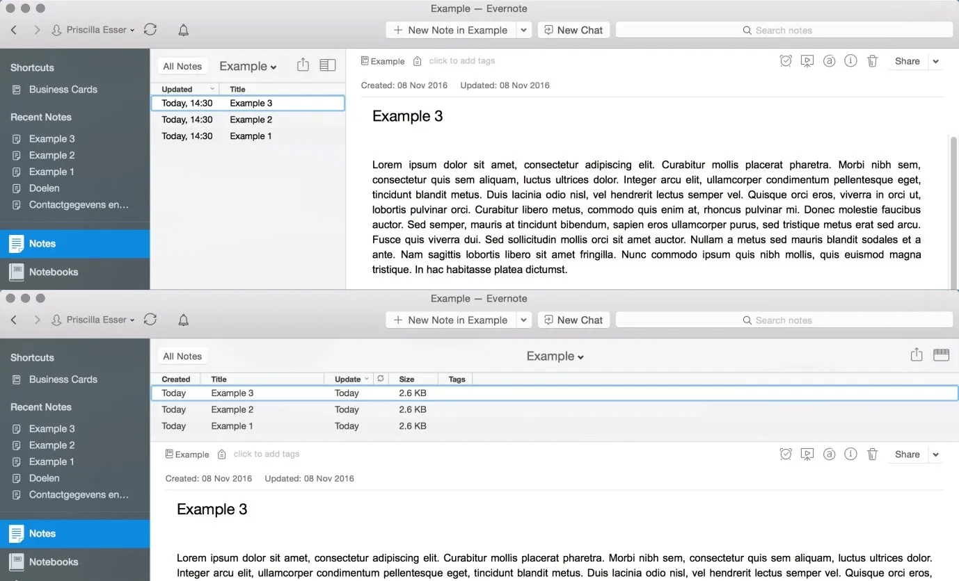
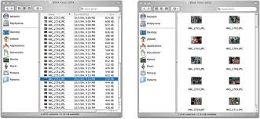

Slide 22
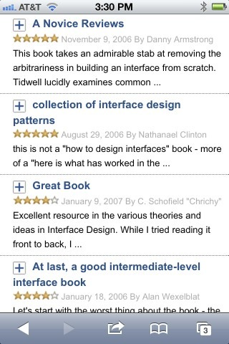
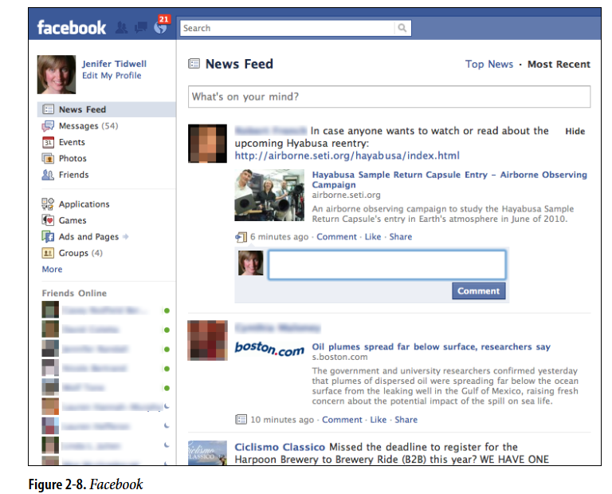

Slide 23
3.Picture Manager- WHAT & WHEN
Use thumbnails, item views, and a browsing interface to create a familiar structure for managing photos, videos, and other pictorial items.
People use your software to work with lists or collections of pictorial things: photos, drawings, video clips, and so on.
The list might be in a web page, or in an application, or both.
It might allow editing by the owner of the content, or it might simply show the content to the public for browsing, viewing, and comments.

Slide 24
Picture Manager- HOW
Set up two principal views:
Thumbnail Grid of the items in the list
large view of a single item.
Users will go back and forth between these.
Design a browsing interface and associate it with the Thumbnail Grid to let users explore a large collection easily.

Slide 25
THUMBNAILS
Use the Thumbnail Grid to display a sequence of items
Many Picture Managers show a small amount of metadata with each item, such as its filename or author, and it offer a control to adjust the size of the thumbnails.
There may also be a way to sort the items by different criteria, such as date, label, or rating, or to filter it and show only the starred items (for instance).
When a user clicks on an item, show it immediately in the single-item view.

Slide 26
THUMBNAILS
If the user owns the items, offer ways to move, reorder, and delete items at this level in the interface.
Cut, copy, and paste should also work in applications

Slide 27
Single-Item View
The Single-Item View provides a detailed, large view of a selected item (image or video), along with relevant metadata and additional features.
Layout Options:
Two-Panel Selector: Use this layout to show the Single-Item View alongside the Thumbnail Grid if screen space allows.
One-Window Drilldown: Replace the Thumbnail Grid with the Single-Item View for a more focused experience on smaller screens.

Slide 28
Single-Item View
Editing features for individual items will live here, also. For instance, a photo manager might offer simple functionality such as cropping, color and brightness adjustment, and red-eye reduction
Use Button Groups to maintain a simple, comprehensible visual grouping of all these features.
If the interface is web-based, consider adding social features in the Single-Item View. This can include options for users to comment, like, or share the item, as well as tag or label it either privately or publicly.
Additionally, providing a recommendation feature for “other items you may like” can enhance the browsing experience and encourage further exploration.

Slide 29
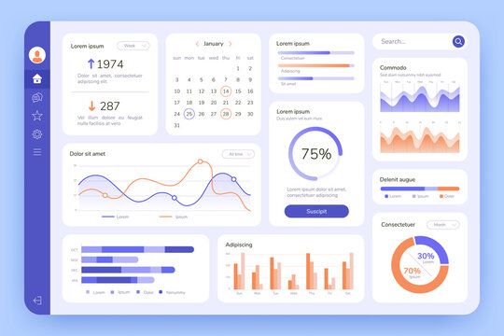
4. Dashboard
Dashboard is a type of graphical user interface which often provides at-a-glance views of data relevant to a particular objective or process through a combination of visualizations and summary information
Arrange data displays into a single information-dense page, updated regularly.
Show users relevant, actionable information, and let them customize the display as necessary

Slide 30
Dashboards are a well-known and familiar page style, both online and offline. They display useful information and update automatically.
Typically, they use graphics like charts and graphs to present data in an easy-to-understand way.
To design an effective dashboard, follow these steps:
Identify Key Information: Determine what users need or want to see.
Use Visual Hierarchy: Arrange information clearly using lists, tables, and graphics. Keep important data visible on one page without excessive scrolling.
Enable Drilldown: Allow users to click on elements to view more details. Datatips work well to show individual data points when the pointer rolls over an information graphic.

Slide 31
4. Choose the Right Graphics: Use simple line and bar charts for comparing data, especially over time. For numbers and text, use lists and tables.
5. Highlight Key Information: Make important text and numbers stand out so users can quickly spot actionable information
6. Allow Customization: Letting them rearrange sections and select which widgets or gadgets to display.

Slide 32
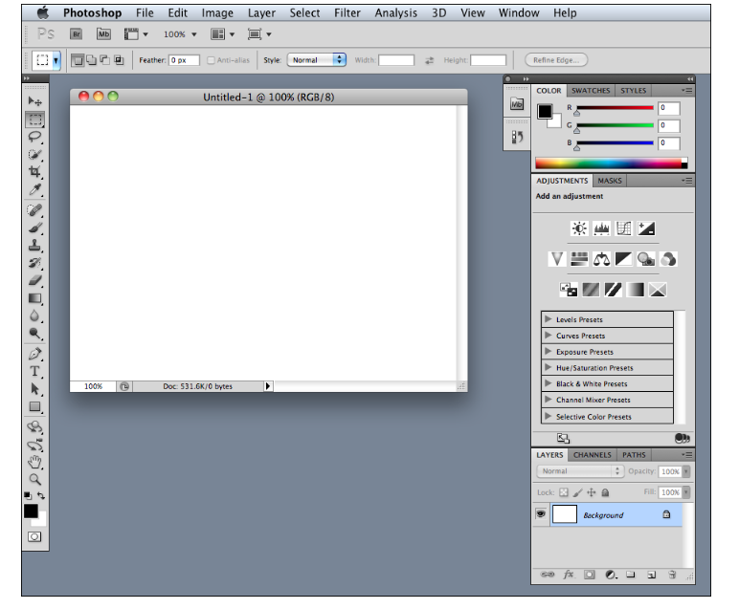
5. Canvas Plus Palette
Place an iconic palette next to a blank canvas; the user clicks on the palette buttons to create objects on the canvas.

Slide 33
This pair of panels
a palette for choosing tools
a canvas for creating
are common in desktop software.
They mirror real-life objects, making them easy to understand.
The palette uses familiar icons, like paintbrushes and magnifying glasses, which are consistently used across different applications.

Slide 34
Create a large empty area as the canvas where users can work. This canvas can be in its own window or part of a page with other tools. Place the canvas next to a palette that contains tool icons.
The palette should have a grid of buttons with icons, and text if needed, to make it clear what each button does. Position the palette to the left or top of the canvas, and you can organize it with tabs or collapsible panels.
Most buttons on the palette will directly create items on the canvas. However, you can also include functions like zoom or selection tools. Different applications use various methods to interact with the palette, such as drag-and-drop or clicking, so testing these interactions is crucial to ensure usability.

Slide 35
6. Settings Editor
Provide an easy-to-find, self-contained page or window where users can change settings, preferences, or properties.
A user must be able to find and edit a desired property without being forced to walk through a prescribed sequence of steps—random access is important.
To aid findability, the properties should be grouped into categories that are well labeled and make immediate sense.
Another important aspect of Settings Editor design is that people will use it for viewing existing settings, not just changing them. The design needs to communicate the values of those settings at a glance.

Slide 36
To design an effective settings editor:
Make It Findable: Place settings in standard locations. For apps, follow common conventions; for websites, put account and profile links where the username is, usually in the upper-right or -left corner.
Organize Properties: Use card sorting with users to determine these groups and their names. Avoid deep hierarchies that require too many clicks to navigate.
Choose a Layout: Use common layouts like tabs, two-panel selectors, or one-window drilldowns
Form Design: patterns and techniques for designing forms.
Apply Changes: Decide whether to apply changes immediately or use Save and Cancel buttons based on the type of settings and established conventions. Test with users to determine the best approach.

Slide 37
7. Alternative Views
Let the user choose among alternative views that are substantially different from the default view.
If you're building a tool for viewing or editing complex content, you may already offer basic customizations like font size or zoom level.
However, if you need to accommodate more complex needs or conflicting requirements, you have to provide different design with different feature sets. Let users choose between these versions to meet their specific needs.

Slide 38
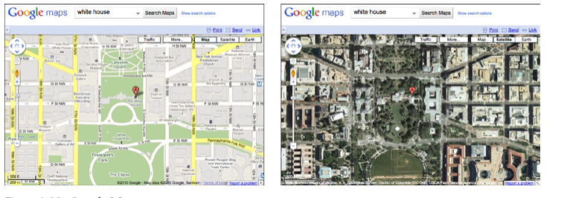

Slide 39
WHY
There are several reasons for Alternative Views:
Users have preferences with regard to speed, visual style, and other factors.
A user might need to temporarily view data through a different “lens” or perspective in order to gain insight into a problem.
If a user is editing a slideshow or website, for instance, he may do most of his editing while using a “structural” view of the document, containing editing handles, markers for invisible content, layout guides, private notes, and so on. But sometimes he will want to see the work as an end user would see it.

Slide 40
HOW
Design specialized views for the scenarios, and present them as alternatives within the same window or screen.
In these alternative views, some information might be added and some might be taken away, but the core content should remain more or less the same.
A common way to switch views is to change the rendering of a list; file finders in both Windows and Mac OS let users switch from lists to Thumbnail Grids to Tree Tables to Cascading Lists to Carousels, for instance.

Slide 41
HOW
Most applications represent the alternative views with iconic buttons.
As the user switches back and forth, preserve all of the application’s current state selections, the user’s location in the document, uncommitted changes, undo/redo operations, and so on .
If a user decides to switch to an alternative view, the application will just use that view by default next time.
Websites can do this by using cookies; desktop applications can keep track of preferences per user; an app on a mobile device can simply remember what view it used the last time it was invoked.
Web pages may have the option of implementing Alternative Views as alternative CSS pages.

Slide 42
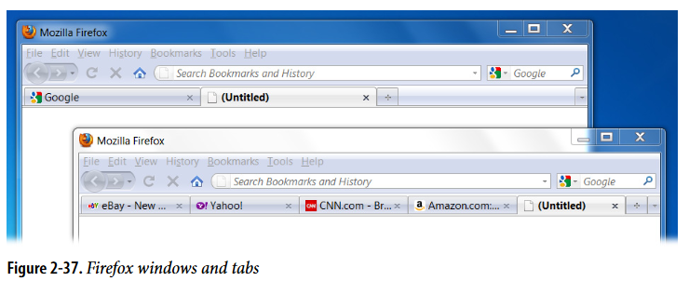
Many Workspaces
Use multiple top-level tabs, tab groups, and windows so that users can view more than one page, project, file, or context at a time.
Let users place these workspaces side by side if possible.

Slide 43
WHY
People multitask.
They go off on tangents, abandon trains of thought, stop working on task A to switch to task B, and eventually come back to something they left hanging.
One way or the other, they will multitask, so you might as well support it directly with a well- designed interface for doing so.
Side-by-side comparisons between two or more items can help people learn and gain insight.
Let users pull up pages or documents next to each other without having to laboriously switch context from one to another.
This pattern directly supports some patterns, such as Prospective Memory (a user may leave a window open as a self-reminder to finish something) and Safe Exploration

Slide 44
HOW
Choose one or more ways to show multiple workspaces.
Many well-known applications use the following:
Tabs
Separate operating-system windows
Columns or panels within a window
Split windows, with the ability to adjust the splitters interactively
If you deal with fairly simple content in each workspace such as text files, lists, or News Streams split windows or panels work fine.
More complex content might warrant entire tab pages or windows of their own so that a user can see a larger area at once.

Slide 45
When users close some web browsers, such as Chrome, the set of workspaces (all open web pages, in tabs and windows) gets automatically saved for later use.
Then when the user restarts the browser, her entire set of previously opened web pages is restored, almost as she left it. This is especially nice when the browser or machine has crashed.

Slide 46
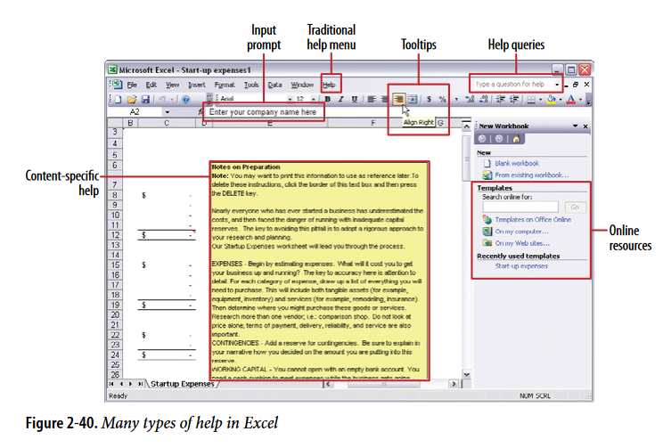
Multi-Level Help

Slide 47
Multi-Level Help
Use a mixture of lightweight and heavyweight help techniques to support users with varying needs
When designing a complex application, it's crucial to support both beginners and experienced users effectively.
Some users may need a full-fledged help system, but most users won’t take the time to use it

Slide 48
Multi-Level Help- WHY
Users of almost any software artifact need varying levels of support for the tasks they’re trying to accomplish.
Someone approaching it for the first time ever (or the first time in a while) needs different support than someone who uses it frequently.
Even among first time users, enormous differences exist in commitment level and learning styles.
Some people want to read a tutorial, some won’t; most find tool tips helpful, but a few find them irritating

Slide 49
Multi-Level Help- WHY
Help texts that are provided on many levels at once even when they don’t look like traditional “help systems” reach everyone who needs them.
Many good help techniques put the help texts within easy reach, but not directly in the user’s face all the time, so users don’t get irritated.

Slide 50
Multi-Level Help- HOW
Captions and instructions directly on the page, including patterns such as Input Hints and Input Prompt
Tool tips. Use them to show very brief, one- or two-line descriptions of interface features that aren’t self-evident
Hover Tools. These can display slightly longer descriptions, shown dynamically as the user selects or rolls over certain interface elements.
Longer help texts contained inside Collapsible Panels
Introductory material, such as static introductory screens, guided tours, and videos.
Help shown in a separate window, often in HTML via browsers, but sometimes in WinHelp or Mac Help.
Live” technical support, usually via email, the Web, Twitter, or telephone.
Informal community support

Slide 51
MODULE- 4
(2nd Series Exam portions)

Slide 52
BOOTSTRAP (MODULE 4 Cont..)
Contents:
Css box MODEL
CSS2 AND CSS3 DIFFERENTIATION
INTEGRATION OF CSS WITH HTML
FLEXBOX AND GRID SYSTEM

Slide 53
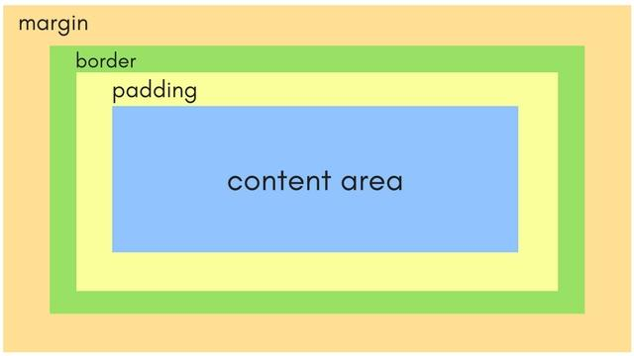
Css box model

Slide 54
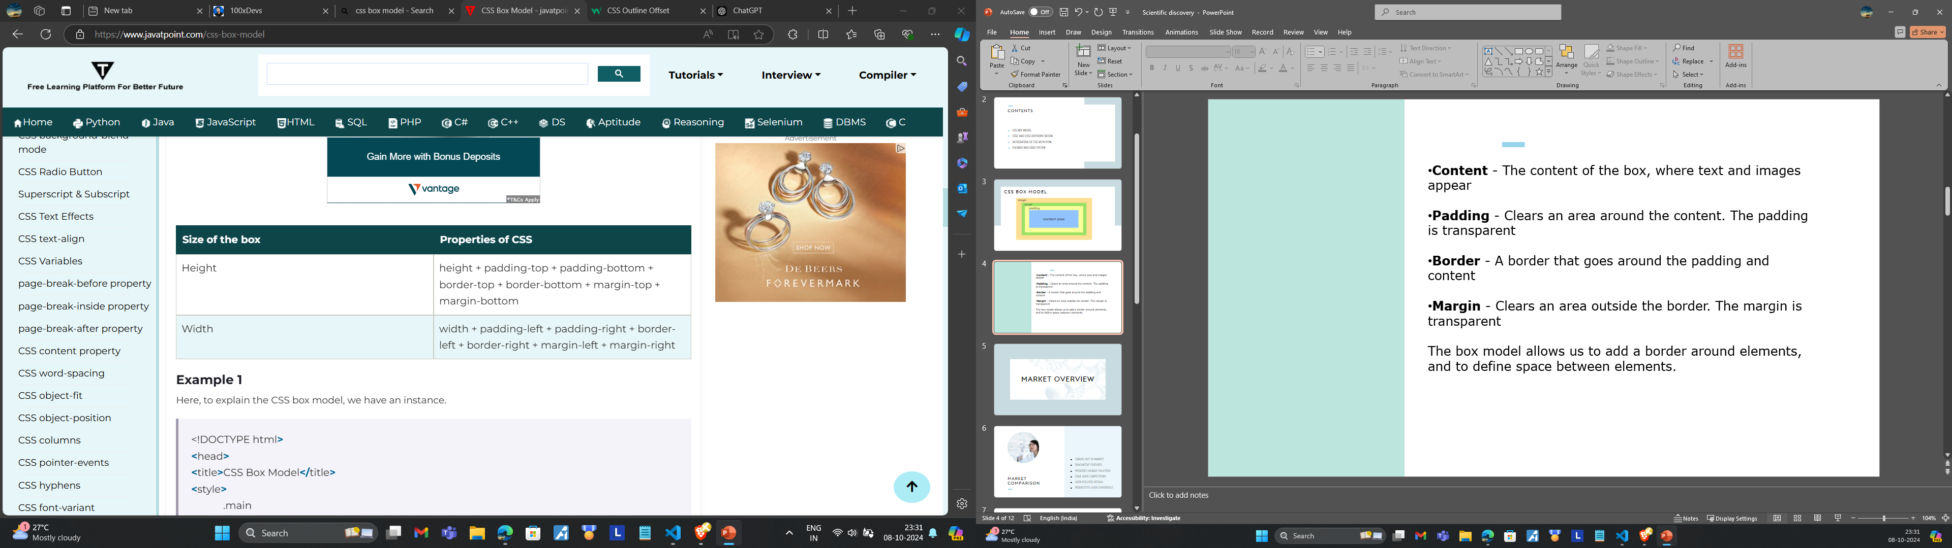
Content - The content of the box, where text and images appear
Padding - Clears an area around the content. The padding is transparent
Border - A border that goes around the padding and content
Margin - Clears an area outside the border. The margin is transparent
The box model allows us to add a border around elements, and to define space between elements.

Slide 55
CSS-2 And CSS-3
CSS-3
Divided into modules for easier updates.
Advanced selectors (attribute, pseudo-class, universal).
Enhanced with box-sizing for better control of element sizes.
Introduced Flexbox and Grid for advanced layouts
Smooth transitions and keyframe animations
Fully supports responsive design through media queries.
CSS-2
Single, large specification.
Simple selectors (class, ID, descendant).
Basic box model.
Layouts via floats, tables, and positioning
No transitions or animations
Requires workarounds for responsive design.

Slide 56
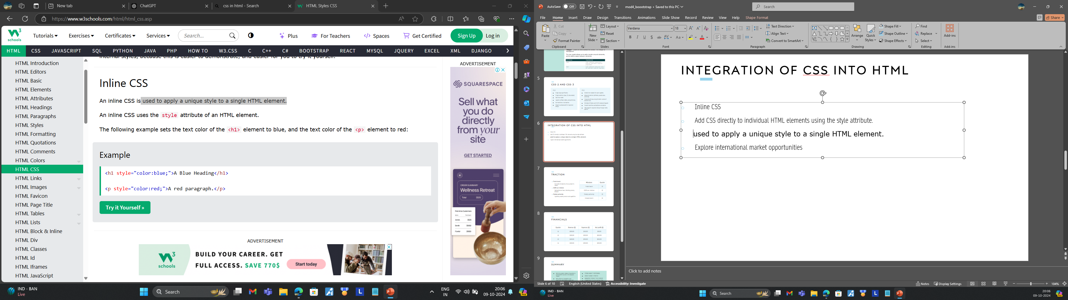
Integration of css into html
Inline CSS
Add CSS directly to individual HTML elements using the style attribute.
Used to apply a unique style to a single HTML element.
Internal CSS
You can include CSS within the <style> tag inside the<head section of your HTML document.
Used to define a style for a single HTML page.

Slide 57
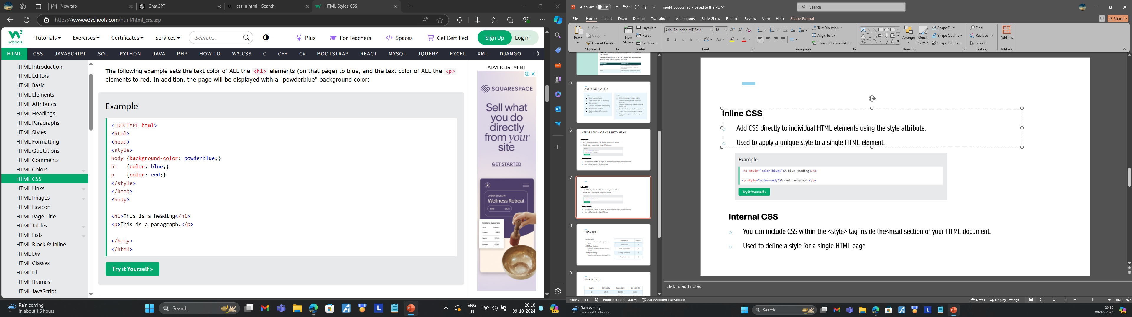

Slide 58
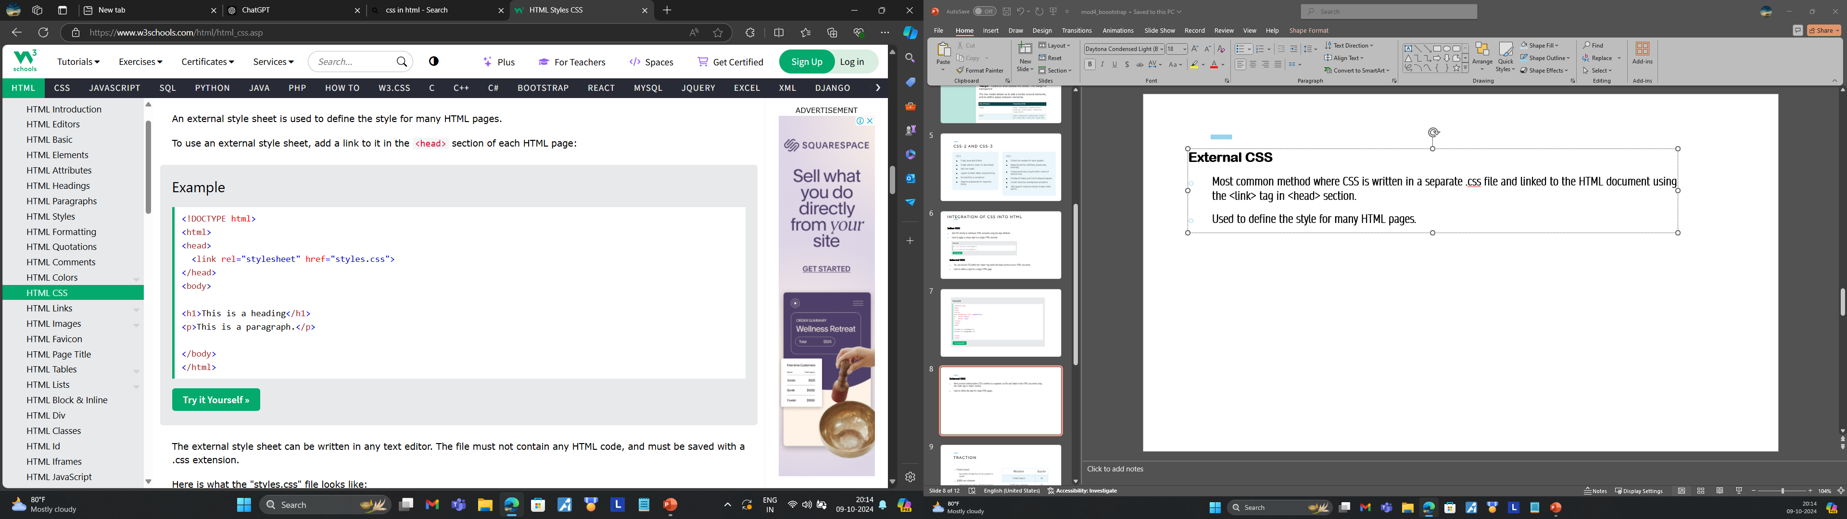
External CSS
Most common method where CSS is written in a separate .css file and linked to the HTML document using the <link> tag in <head> section.
Used to define the style for many HTML pages.

Slide 59
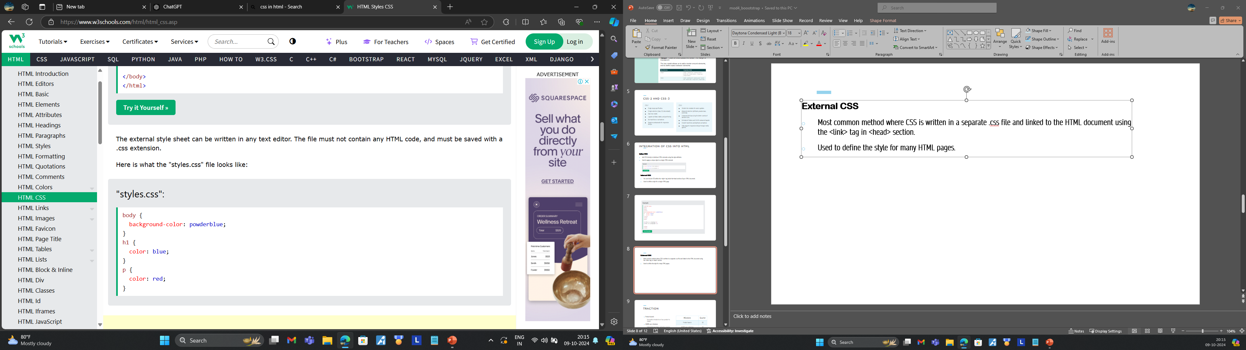

Slide 60
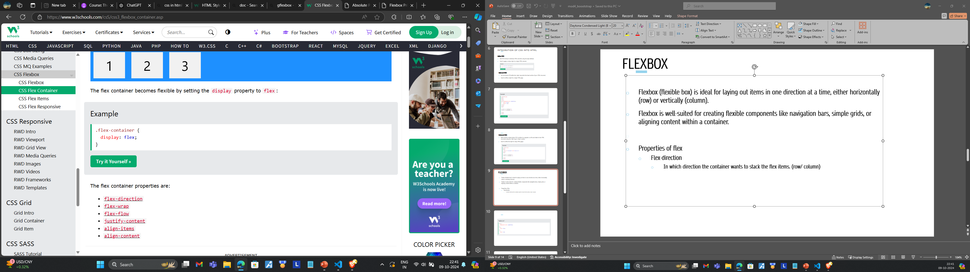
FLEXBOX
Flexbox (flexible box) is ideal for laying out items in one direction at a time, either horizontally (row) or vertically (column).
Flexbox is well-suited for creating flexible components like navigation bars, simple grids, or aligning content within a container.

Slide 61
FLEXBOX
Properties of flex
flex-direction
In which direction the container wants to stack the flex items. (row/ column)
Flex-wrap
The wrap value specifies that the flex items will wrap if necessary.
Wrap, nowrap, wrap-reverse
Justify-content
The justify-content property is used to align the flex items.
Center, flex-start, flex-end, space-around, space-between
Align Items
The align-items property is used to align flex
Flex-start, flex-end, stretch, baseline

Slide 62
FLEXBOX
HTML Code:
html
<!DOCTYPE html>
<html lang="en">
<head>
<meta charset="UTF-8">
<meta name="viewport" content="width=device-width, initial-scale=1.0">
<title>Flexbox Example</title>
<link rel="stylesheet" href="styles.css">
</head>
<body>
<div class="container">
<div class="box">Box_1</div>
<div class="box">Box_2</div> <div class="box">Box 3</div>
<div class="box">Box 4</div>
<div class="box">Box 5</div>
</div>
</body>
</html>

Slide 63
CSS Code
/* Flex container */
.container {
display: flex; /* Use flexbox layout */
flex-direction: row; /* Arrange items in a row (horizontal) */
flex-wrap: wrap; /* Allow items to wrap onto multiple lines */
justify-content: space-between; /* Distribute items with space between them */
align-items: center; /* Align items along the cross-axis (vertical in this
height: 200px; /* Set height of the container */
background-color: lightgray;
}
/* Flex items */
.box {
background-color: skyblue;
color: white;
padding: 20px;
margin: 10px;
text-align: center;
flex: 1 1 100px; /* Allow each box to grow and shrink */
}

Slide 64
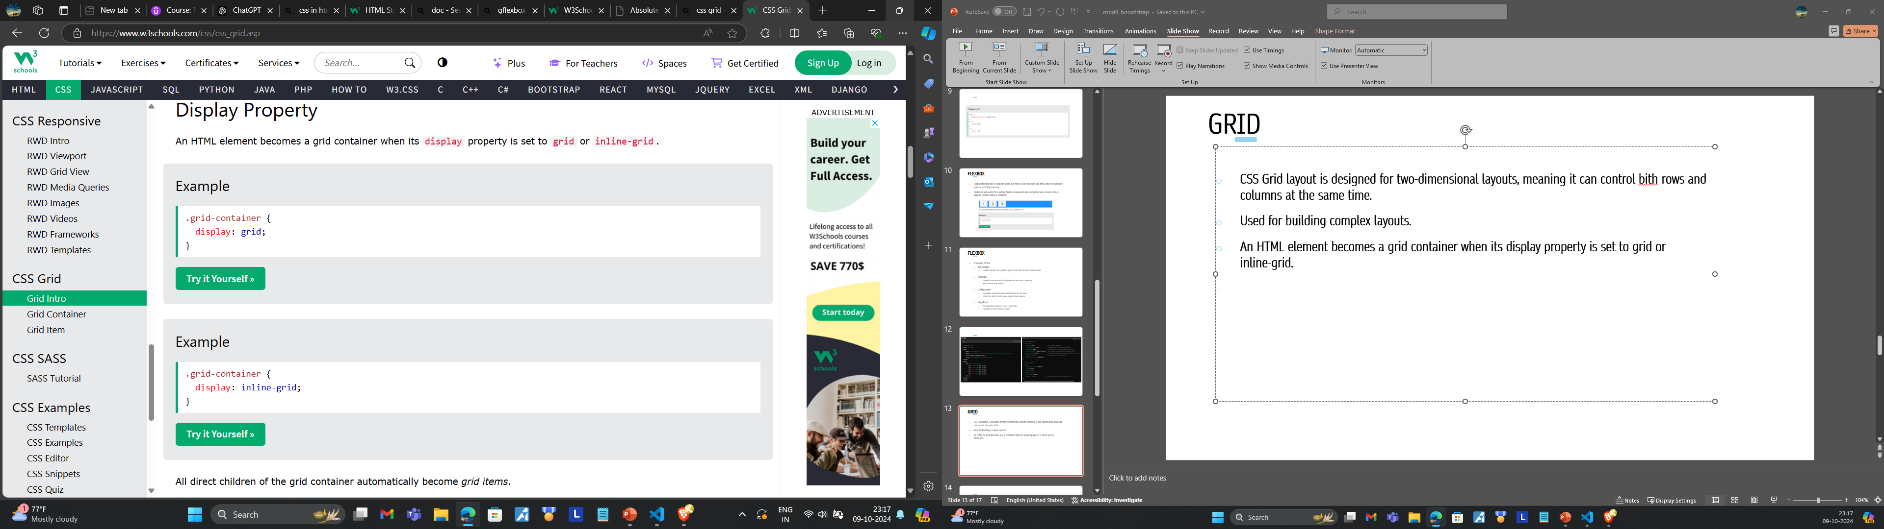
GRID
CSS Grid layout is designed for two-dimensional layouts, meaning it can control bith rows and columns at the same time.
Used for building complex layouts.
An HTML element becomes a grid container when its display property is set to grid or inline-grid.

Slide 65
GRID
Properties of grid
gap
Specifies the gap, column-gap: for gap between columns, row-gap: for gap between rows
Grid-template-columns
The grid-template-columns property defines the number of columns in your grid layout, and it can define the width of each column.
Grid-template-rows
Defines the height of each row.

Slide 66
GRID
HTML Code:
<!DOCTYPE html>
<html lang="en">
<head>
<meta charset="UTF-8">
<meta name="viewport“ content="width=device-width, initial-scale=1.0">
<title>Grid Layout Example</title>
<link rel="stylesheet" href="styles.css">
</head>
<body>
<div class="grid-container">
<div class="grid-item">Item 1</div>
<div class="grid-item">Item 2</div>
<div class="grid-item">Item 3</div>
<div class="grid-item">Item 4</div>
<div class="grid-item">Item 5</div>
<div class="grid-item">Item 6</div>
</div>
</body>
</html>

Slide 67
CSS Code
/* Grid container */
.grid-container {
display: grid; /* Use grid layout */
grid-template-columns: 1fr 2fr 1fr; ; /* Define 3 columns: 1 fraction, 2 fractions,
grid-template-rows: 100px 200px /* Define 2 rows: first row is 100px, second r
grid-gap: 10px; /* Set the gap between grid items */
justify-items: center; /* Center items horizontally */
align-items: center; /* Center items vertically */
background-color: lightgray;
padding: 20px;
}
/* Grid items */
.grid-item {
background-color: skyblue;
color: white;
padding: 20px;
font-size: 1.5em;
text-align: center;
}

Slide 68
Difference Between Grid and Flexbox:
1. Dimensionality and Flexibility:
Flexbox offers greater control over alignment and space distribution between items. Being one-dimensional, Flexbox only deals with either columns or rows.
Grid has two-dimension layout capabilities which allow flexible widths as a unit of length. This compensates for the limitations in Flex.
2. Alignment:
Flex Direction allows developers to align elements vertically or horizontally, which is used when developers create and reverse rows or columns.
CSS Grid deploys fractional measure units for grid fluidity and auto-keyword functionality to automatically adjust columns or rows.

Slide 69
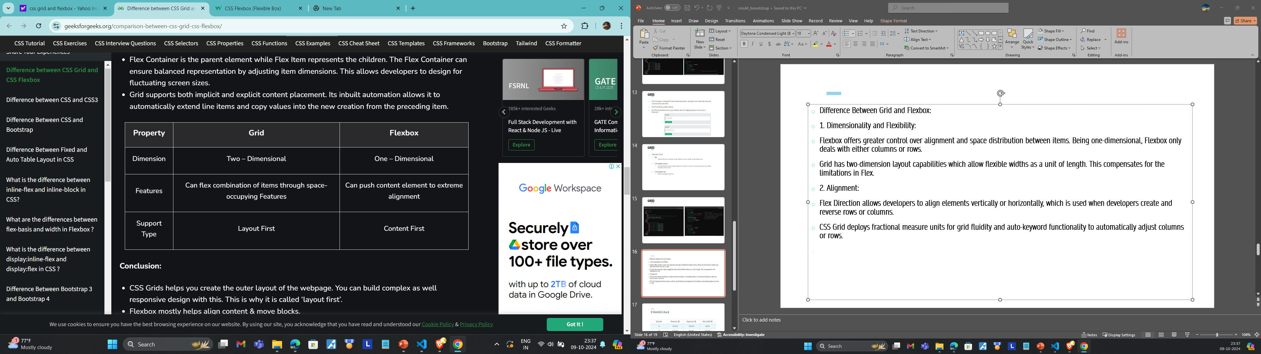

Slide 70
The Patterns

Slide 71
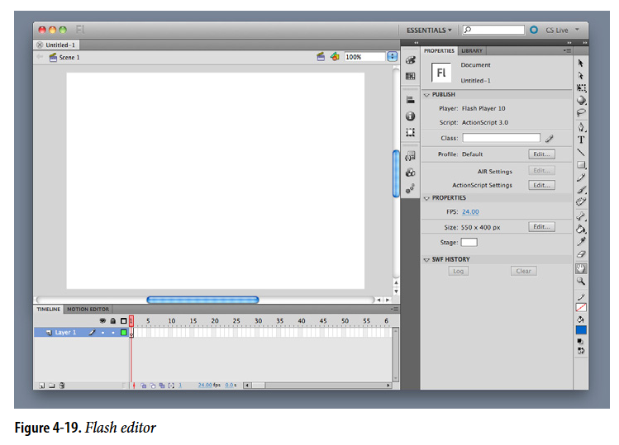
Center Stage
Put the most important part of the UI into the largest subsection of the page or window; cluster secondary tools and content around it in smaller panels.

Slide 72
Center Stage
The page’s primary job is to show a single unit of coherent information to the user, let him edit a document, or enable him to perform a certain task.
Other content and functions are secondary to this one.
Why
The design should guide the user’s eyes immediately to the start of the most important information (or task) rather than have them wandering over the page in confusion

Slide 73
WHY
A clear central entity in a user interface acts as an anchor for the user's attention, much like the lead sentence in a news article sets the stage for the content.
This focal point establishes the UI's purpose, allowing users to easily assess surrounding elements in relation to it.
Instead of scanning the page multiple times to determine the order and relevance of information, users can quickly understand how peripheral items connect to the central theme, enhancing their overall navigation and comprehension.

Slide 74
HOW
Establish a visual hierarchy with the primary content or document dominating everything else
When designing a Center Stage, consider following factors,
1. Size - The Center Stage content should be at least twice as wide as whatever’s in its side margins, and twice as tall as its top and bottom margins.
2. Color- Use a color that contrasts with the items in the margins. In desktop UIs, white works well against Windows gray, especially for tables and trees.
As it happens, white often works in web pages too, since ads and navigation bars usually use other colors as their backgrounds; also, web users have been “trained” by convention to look for the plain text on a white background.

Slide 75
3. Headlines- Big headlines are focal points, and can draw the user’s eye to the top of the Center Stage.
4. Context- What does the user expect to see when she opens up the page? A graphic editor? A long text article? A map? A filesystem tree? Work with her preconceptions; put that in Center Stage and make it recognizable.

Slide 76
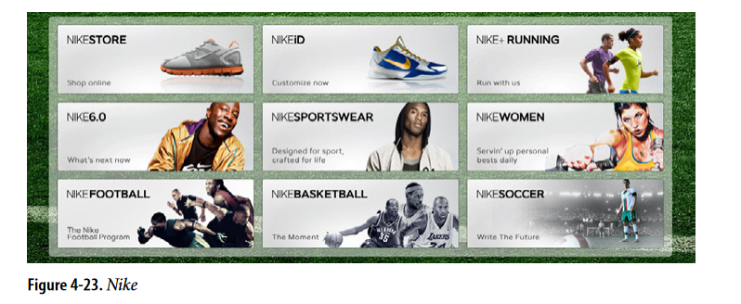
Grid of Equals
Arrange content items in a grid or matrix. Each item should follow a common template, and each item’s visual weight should be similar. Link to jump pages as necessary

Slide 77
The page contains many content items that have similar style and importance, such as news articles, blog posts, products, or subject areas.
You want to present the viewer with rich opportunities to preview and select these items.
WHY
A grid that gives each item equal space announces that they have equal importance.
The common template for items within the grid tells the user that the items are similar to each other.
Together, these techniques establish a powerful visual hierarchy that should match the semantics of your content.
Grids look neat, ordered, and calming. That may suit the style of your site or app.

Slide 78
HOW
Figure out how to lay out each item in the grid.
Do they have thumbnail images or graphics? Headlines, subheads, summary text? Links to jump pages (e.g., a page with the fullstory)?
To create an engaging layout, use colorful headlines for each section—blue for events and green for highlights. Add plenty of whitespace to keep it clean and readable.
Arrange the items in a grid with tall, wide, or square boxes, including images alongside the text.
This way, important details like dates and descriptions are clear and easy to find while making the overall presentation visually appealing.

Slide 79
Arrange items in a grid with two or three items per row, making sure it looks good on narrow screens and mobile devices.
Use hover effects to highlight specific items with color changes, but keep their size and position the same.
This way, the design stays stable while still drawing attention to key elements, ensuring a smooth experience for users.

Slide 80
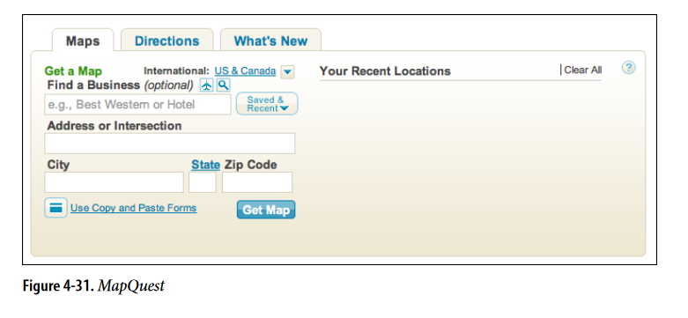
Module Tabs
Put modules of content into a small tabbed area so that only one module is visible at a time. The user clicks on tabs to bring different modules to the top.

Slide 81
Use when
You have a lot of heterogeneous content to show on the page, possibly including text blocks, lists, buttons, form controls, or images. You don’t have room for everything.
Some of the page content comes in groups or modules (or can be sorted into coherent groups).
Those modules have the following characteristics:
Users only need to see one module at a time.
They are of similar length and height.
There aren’t many modules—fewer than 10, and preferably a small handful.
The set of modules is fairly static; new pages won’t be added frequently, nor will existing pages be changed or removed frequently.
The modules’ contents may be related or similar to each other.

Slide 82
WHY
Tabs are common in desktop interfaces and websites, making them easy to understand. They effectively group and hide content, helping to declutter the interface. This way, users can easily switch between different sections without feeling confused

Slide 83
How
First, get the information architecture right. Split up the content into coherent chunks, if it hasn’t already been done for you, and give them short, memorable titles (one or two words, if possible).
If you split up the content incorrectly, users will be forced to switch back and forth between tabs as they compare them or look for information they can’t find.
Indicate the selected tab unambiguously, such as by making it contiguous with the panel itself.

Slide 84
Accordions and
Collapsible Panels

Slide 85
What is an Accordion?
Stacks modules of content vertically.
Allows independent opening/closing
of each module.
Ideal for heterogeneous content such
as text blocks, lists, images, etc.
User-friendly for limited space pages.

Slide 86
When to Use?
When there is a large amount of content
that needs organization.
When modules are part of a tool palette
or two-level menu.
When user want to see more than one
module at a time.
When preserving the linear order.
When modules are of different height
but in same width.

Slide 87
Why?
Familiar and interactive web element.
Helps declutter pages and applications.
Useful in web navigation and desktop
applications.
Allows users to customize their interface
by keeping open relevant modules.

Slide 88
How to Use?
Arrange Modules Vertically:
Use Rotating Triangle Icons:
Organize your modules in a vertical stack.
Provide a short, descriptive title for each module
Indicate whether a module is open or closed
with a triangle icon.
Rightward Triangle: Closed state.
Downward Triangle: Open state.

Slide 89
How to Use?
3. Multiple Modules Open at Once:
4. Preserve State Across Sessions:
Allow more than one module to be open simultaneously.
Provide a short, descriptive title for each module
Ensure the accordion remembers its open and closed
state between sessions for logged-in users.
Useful in tool palettes or applications where
consistency matters.

Slide 90
Examples

Slide 91
What is an Collapsible Panel?
Contains secondary or optional content.
Panels open/close to free space for main content.
Often used for sidebars, comments, or extra information.

Slide 92
When to Use?
When modules are not essential, they remain
closed by default to avoid clutter.
When they are not essential enough to be open by default.
When modules are not needed, collapsing them
optimizes space for the main content.
When users interact with the page, the importance of modules
varies, as some find specific ones more useful than others.
When using Collapsible Panels, they are independent and
do not suggest relationships, unlike Tabs or Accordions.

Slide 93
Why?
Hiding non-essential content makes
the interface simpler.
Collapsing modules creates more space for
the main content.
This approach shows content only when needed.
Grouping and hiding content helps keep the interface tidy.
Collapsible Panels are one tool among others
like Tabs and Accordions.

Slide 94

How to Use?
Clear Labeling and Visual Indicators
Use descriptive titles for panels
Include “More” labels and chevron icons to
indicate expandable content.
User Interaction
Allow panels to open and close with one click.
Set frequently opened panels to be open by default.

Slide 95
Smooth Transitions
Use animations for opening and closing to enhance user experience.
Space Management
Collapse closed panels to optimize layout and improve readability.
Content Grouping and Independence
Group related modules in one panel with Tabs or an Accordion.
Keep panels independent to avoid implying relationships.

Slide 96
Examples

